Slide 1
Re-viewing the CMI Framework
(Re-view: Take another look, see anew)

Slide 2
Cathy Seeley, UCTM Conference, Nov. 4, 2011
Use the implementation of the Common Core State Standards in Mathematics as leverage for improving instructional practice.

Slide 3
CCSS-M motivates the need for new instructional practices
Mathematical Practices
Learning Progressions (informed both by research on children's cognitive development and by the logical structure of mathematics)
De-fragmenting the Math (“Graph proportional relationships, interpreting the unit rate as the slope of the graph.”)
Instructionally-demanding Verbs (“Write a function defined by an expression in different but equivalent forms to reveal and explain different properties of the function.”)
Notes:
What indicators are there in the CCSS that would suggest that successful implementation of the common core will require new instructional practices?

Slide 4
Naïve Perspectives on Mathematics Instruction Reform (“Math Wars”)
Discovery learning
“Hands-on activities”
“Tons of discussion, group work, student sharing of strategies”
Notes:
Based on the TIMSS study and classroom observation, teachers often take the wrong message from their exposure to inquiry-based mathematics instruction. The intent of the CMI Framework is to provide an intuitive, unifying vision of mathematical instruction that helps teachers focus on the real-intent of inquiry-based instruction (making sense of mathematics), and yet is robust enough to be able to connect the evolving body of research and theory to it.

Slide 5
Need for an instructional framework in mathematics education
Chazan and Ball (1999) expressed frustration with “current math education discourse about the teacher’s role in discussion-intensive teaching.” They argue that educators are often left “with no framework for the kinds of specific, constructive pedagogical moves that teachers might make.”
Stein et al. (2008) refer to a first generation of instructional reform from which “many teachers got the impression that in order for discussions to be focused on student thinking, they must avoid providing any substantive guidance at all,” and they refer to a second generation of instructional reform “that re-asserts the critical role of the teacher in guiding mathematical discussions.”
Notes:
Teachers need a framework—we can’t ask them to discard a transmission-based framework without supporting them with a new, more effective framework. Otherwise, they create ways of thinking that are not productive and conducive to learning.

Slide 6
Intent of the CMI (Comprehensive Mathematics Instruction) Framework
Cognitive Demand (the nature of worthwhile tasks)
Five Practices (orchestrating mathematical discourse)
Sociomathematical Norms (teacher’s role in creating learning environments that press for understanding)
Landscape of Learning (conceptual, procedural, representational domains of mathematics)
NCTM Process Standards / Mathematical Practices (engaging in authentic mathematical practice)
Learning Trajectories and Progressions (curriculum design)
Depth of Knowledge (DOK) Assessment
Mathematical Knowledge for Teaching (MKT)
Reflective Practitioner (INTASC Standards)
Notes:
I recognize that the PDs we are planning are about CCSS-M at specific grade levels and not about CMI—consequently participants will leave with an intuitive, introductory understanding of the CMI Framework. The intent of the CMI Framework is to provide an intuitive, unifying vision of mathematical instruction.

Slide 7
Three components of the CMI Framework
The Teaching Cycle (addresses pedagogy, the learning environment, orchestrating discourse, and formative assessment)
The Learning Cycle (addresses the cognitive demand of tasks, flow of the unit, content standards and learning trajectories, process standards and mathematical practices, formative and summative assessment)
The Continuum of Mathematical Understanding (addresses conceptual, procedural, and representational thinking; depth of knowledge; and assessment)

Slide 8
The Teaching Cycle
Notes:
Tradition teaching sequence: Review homework, model new procedure with a sequence of carefully chosen examples, students work independently practicing the new procedure
The Teaching Cycle introduces a new teaching sequence that is not unique to CMI (it appears in other instructional frameworks), but with some modification
For example, the notion of a cycle of pedagogical moves (Teachers think in terms of lessons and units rather than in terms of instruction that can occur over several class periods or several times during a single class period)

Slide 9
PEDAGOGICAL PRACTICES SUPPORTED BY THE TEACHING CYCLE: Using Student Thinking
Anticipate Student Thinking
Connect
Student Thinking
Select and Sequence Student Thinking
Monitor
Student Thinking
Notes:
Identifying the teaching cycle allows us to describe and situate several pedagogical practices within that cycle of instruction. For example, “Using Student Thinking” plays out throughout the teaching cycle: anticipating, monitoring, selecting, sequencing and connecting student thinking are connected to the stages of the teaching cycle
Lesson planning as something that occurs before, as well as during a lesson, becomes more explicit

Slide 10
PEDAGOGICAL PRACTICES SUPPORTED BY THE TEACHING CYCLE: Learning Environment
Sociomathematical norms: criteria for attending to and judging the work of peers
Determine groupings: individual, pairs,
small group
Tools to support exploration and discourse
Notes:
“Creating a Shared Learning Environment”: decisions about grouping, tools to support exploration and discourse, what constitutes “showing your work”, what convinces us that an answer is correct—e.g., the social and sociomathematical norms of the classroom are made explicit when connected to the teaching cycle

Slide 11
PEDAGOGICAL PRACTICES SUPPORTED BY THE TEACHING CYCLE: Formative Assessment
What’s next?
What are students taking away from the discussion?
Have we activated appropriate background knowledge? Provided enough information while maintaining the problematic nature of the task?
When are students ready to move to the Discuss stage?
Notes:
Formative assessment drives the Teaching Cycle
Launch: Have we activated appropriate background knowledge, put students in the correct cognitive space, provided enough information for successful exploration while keeping the problematic aspects of the task in place?
Explore: What additional scaffolding do we need to provide to re-view (take another look) or re-focus the student work? When are students ready to move to the Discuss stage? (all finished vs. all have done enough to have access to the discussion)
Discuss: Has our mathematical purpose been met?

Slide 12
PEDAGOGICAL PRACTICES SUPPORTED BY THE TEACHING CYCLE: Mathematical Discourse
Teacher’s role: Orchestrate the structure and flow of the discussion.
Teacher’s role: Launch and clarify the task.
Students role:
Explain and justify one’s own thinking;
Clarify, describe, compare, question the thinking of others.
Teachers role: Ask questions to engage, prompt, guide, clarify, deepen student thinking.
Notes:
“Mathematical Discourse” in the Teaching Cycle
Engaging students in math talk: 5 talk moves
Role of questions in the framework
Students’ role in discourse: conjecture, explain, connect, convince, generalize, transfer

Slide 13
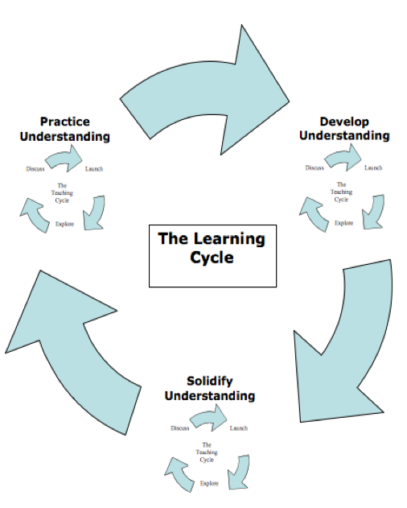
The Learning Cycle
The purpose of a Develop Understanding lesson is to surface student thinking.
The purpose of a Solidify Understanding lesson is to examine and extend student thinking.
The purpose of a Practice Understanding lesson is to acquire fluency and refine student thinking – enabling students to transfer understanding to new “communities of practice”.
Notes:
Example: Mystery Bags
Develop: Students use the bags and balance beam to surface a reasonable strategy for determining the number of gold coins in a bag.
Solidify: What kinds of manipulations work consistently? How do we record the steps symbolically? Can we work with portions of a bag? Negative coins? Given an equation, can we model it with mystery bags? (e.g., groups of bag configurations)
Practice: Writing equivalent equations.
Note that we are spending a lot more time on solidify tasks (to examine and extend), than in develop (where we surfaced thinking about equivalence and keeping things in balance), or practice (which gets redundant when we have the key conceptual ways of thinking).

Slide 14
CURRICULUM DESIGN PRINCIPLES SUPPORTED BY THE LEARNING CYCLE
What constitutes a Worthwhile Mathematical Task?
Contextualized or abstract/symbolic?
Amount of scaffolding provided?
Constraints?
Level of cognitive demand?
Notes:
Just as the teaching cycle supported pedagogical principles, the learning cycle supports principles of curriculum design
Note that “worthwhile” is dependent upon the purpose of the lesson within the learning cycle.

Slide 15
CURRICULUM DESIGN PRINCIPLES SUPPORTED BY THE LEARNING CYCLE
Thinking Through a Unit
Ideas: What do we want students to know?
Strategies: What do we want students to be able to do?
Representations: How do we want students to make their thinking visible?
How do ideas, strategies and representations differ from the beginning to the end of a unit of instruction?
Notes:
Note that the mathematics of a learning cycle is about more than skills.

Slide 16
The Continuum of Mathematical Understanding
Notes:
(Look at this diagram in the handouts while discussing the bullet points on the next slide.)

Slide 17
KEY ASPECTS OF THE CONTINUUM
Three distinct domains of understanding: conceptual, procedural, and representational
Words were chosen to indicate movement across the continuum. For example, ideas that are examined and extended become more solid which we call concepts, and concepts that are refined and fluent become practiced which we call definitions and properties.
This is a continuum, not discrete jumps
Ovals represent the work within teaching cycles
Left to right movement along the continuum represents movement from specific to general, from concrete to abstract
Connections between domains creates movement along the continuum; therefore, one can’t discuss procedures with understanding without referring to the conceptual and representational domains.
Notes:
Idea: recognizing a structure or pattern within a context or across similar contexts (example a student conjectures that the sum of two odd numbers is even after multiple exposures that allows the pattern to emerge)
Concept: beginning to articulate roles (or function) of elements in the structure; giving names to the roles, explaining the pattern or structure across contexts (because an odd number is made of pairs plus and extra, when two odd numbers are added together the “extra” in each odd number make a pair)
Definitions and properties: precise and concise statement that captures the essential nature of the pattern or structure for “all” circumstances (Example: an odd number can be written in the form 2n+1 where n is a natural number; the sum of two odd numbers is even since 2n+1+2m+1=2(n+m+1)
Strategy: a set of purposeful, context-dependent actions
Algorithm: a set of identified, labeled, general steps for repeatability across contexts
Procedure: a reduction in the number of steps (through combining or elimination) in the algorithm for automaticity and fluency
Representation: used for exploring, explaining or sense-making
Tool: used for reasoning about an idea or strategy
Model: used for organizing and structuring concepts and procedures

Slide 18
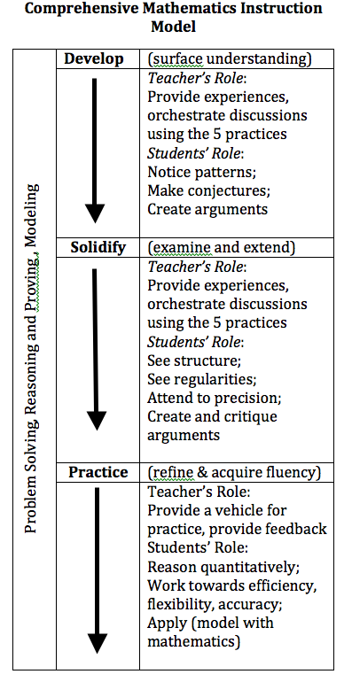
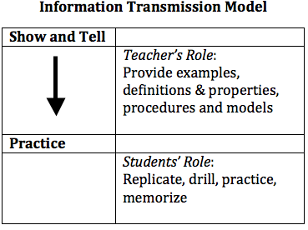
Notes:
We are asking teachers to move away from models of instruction, such as the “information transmission model” to a model that addresses the learning issues identified in current research.
There are other models not on this chart (activity-based instruction, discovery learning) that we also want teachers to move away from.
Note that the “information transmission model” begins and ends at the right end of the continuum, and discovery learning generally begins and ends at the left end.

Slide 19
Design Criteria for Learning Cycle Tasks
It will be sufficient for participants to use the criteria for cognitive demand to select and adapt tasks to fit the learning cycle.
“Doing Mathematics” tasks generally fit the role of surfacing understanding and make good Develop Understanding tasks.
“Procedures with Connections” tasks generally allow students to examine an extend understanding and make good Solidify Understanding tasks.
“Procedures without Connections” tasks always focus on acquiring fluency and may be used as Practice Understanding tasks, along with games, etc. (Generally, low cognitive demand tasks can fit practice understanding goals, but practice understanding tasks don’t have to be low level tasks; strategic games can provide practice and yet be at a high level of cognitive demand. Tasks that refine understanding generally involve modeling and other high level, cognitively demanding work.)

